Slide 1
T-SQL Programming
Chapter 15 Implementing Indexes and Statistics

Slide 2
Storage
Files
Pages/Extents
Partitions
Allocation Units
Reads

Slide 3
Files
At a minimum, every SQL Server database has two operating system files: a data file and a log file. Data files contain data and objects such as tables, indexes, stored procedures, and views. Log files contain the information that is required to recover all transactions in the database. Data files can be grouped together in filegroups for allocation and administration purposes.
Primary
The primary data file contains the startup information for the database and points to the other files in the database. User data and objects can be stored in this file or in secondary data files. Every database has one primary data file. The recommended file name extension for primary data files is .mdf.
Secondary
Secondary data files are optional, are user-defined, and store user data. Secondary files can be used to spread data across multiple disks by putting each file on a different disk drive. Additionally, if a database exceeds the maximum size for a single Windows file, you can use secondary data files so the database can continue to grow.
Transaction Log
The transaction log files hold the log information that is used to recover the database. There must be at least one log file for each database. The recommended file name extension for transaction logs is .ldf.

Slide 4
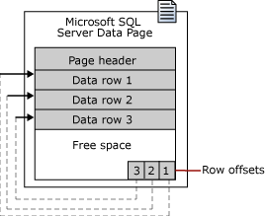
The fundamental unit of data storage in SQL Server is the page. The disk space allocated to a data file (.mdf or . ndf) in a database is logically divided into pages numbered contiguously from 0 to n. Disk I/O operations are performed at the page level. That is, SQL Server reads or writes whole data pages.
Extents are a collection of eight physically contiguous pages and are used to efficiently manage the pages. All pages are stored in extents.
Page
In SQL Server, the page size is 8 KB. This means SQL Server databases have 128 pages per megabyte. Each page begins with a 96-byte header that is used to store system information about the page. This information includes the page number, page type, the amount of free space on the page, and the allocation unit ID of the object that owns the page.

Slide 5
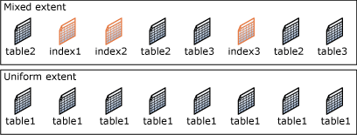
Extent
Extents are the basic unit in which space is managed. An extent is eight physically contiguous pages, or 64 KB. This means SQL Server databases have 16 extents per megabyte.
SQL Server has two types of extents:
Uniform extents are owned by a single object; all eight pages in the extent can only be used by the owning object.
Mixed extents are shared by up to eight objects. Each of the eight pages in the extent can be owned by a different object. allocations.

Slide 6
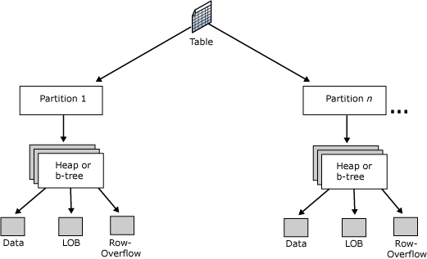
Tables and indexes are stored as a collection of 8-KB pages.
A table is contained in one or more partitions and each partition contains data rows in either a heap or a clustered index structure. The pages of the heap or clustered index are managed in one or more allocation units, depending on the column types in the data rows.
Partition
Table and index pages are contained in one or more partitions. A partition is a user-defined unit of data organization. By default, a table or index has only one partition that contains all the table or index pages.
To view the partitions used by a table or index, use the sys.partitions catalog view.

Slide 7
Allocation Units
An allocation unit is a collection of pages within a heap or B-tree used to manage data based on their page type. The following table lists the types of allocation units used to manage data in tables and indexes.
IN_ROW_DATA: Data or index rows that contain all data, except large object (LOB) data. Pages are of type Data or Index.
LOB_DATA: Large object data stored in one or more of these data types: text, ntext, image, xml, varchar(max), nvarchar(max), varbinary(max), or CLR user-defined types (CLR UDT). Pages are of type Text/Image.
ROW_OVERFLOW_DATA: Variable length data stored in varchar, nvarchar, varbinary, or sql_variant columns that exceed the 8,060 byte row size limit. Pages are of type Text/Image.
A heap or B-tree can have only one allocation unit of each type in a specific partition.

Slide 8
Reads
logical reads Number of pages read from the data cache.
physical reads Number of pages read from disk.
read-ahead reads Number of pages placed into the cache for the query.
„Hard disks are slow; memory is fast. This is a fact of nature for anyone that works with computers. Even SSDs are slow when compared to high-performance memory. The way in which software deals with this problem is to write data from slow storage into fast memory. Once loaded, your favorite apps can perform very fast and only need to go back to disk when new data is needed. This fact of life in computing is also an important part of SQL Server architecture.
Whenever data is written to or read from a SQL Server database, it will be copied into memory by the buffer manager. The buffer cache (also known as the buffer pool) will use as much memory as is allocated to it in order to hold as many pages of data as possible. When the buffer cache fills up, older and less used data will be purged in order to make room for newer data.”

Slide 9
Implementing Indexes
Heaps and Balanced Trees

Slide 10
Heap
A heap is a table without a clustered index. One or more nonclustered indexes can be created on tables stored as a heap. Data is stored in the heap without specifying an order. Usually data is initially stored in the order in which is the rows are inserted into the table, but the Database Engine can move data around in the heap to store the rows efficiently; so the data order cannot be predicted.
To guarantee the order of rows returned from a heap, you must use the ORDER BY clause. To specify the order for storage of the rows, create a clustered index on the table, so that the table is not a heap.
If a table is a heap and does not have any nonclustered indexes, then the entire table must be examined (a table scan) to find any row. This can be acceptable when the table is tiny, such as a list of the 12 regional offices of a company.

Slide 11
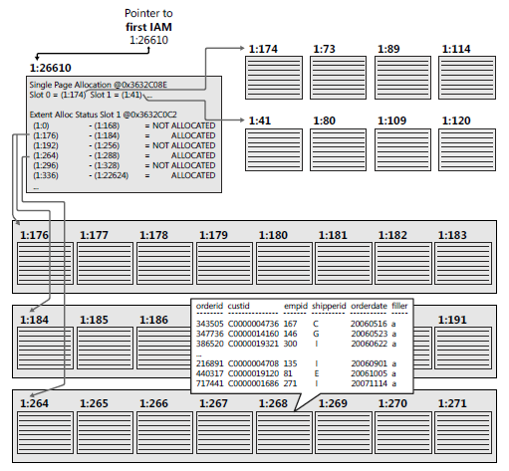
Heap

Slide 12
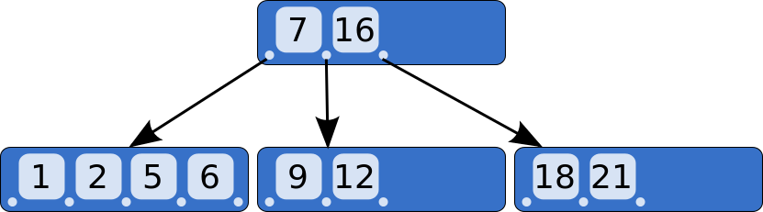
B-Tree
In computer science, a B-tree is a self-balancing tree data structure that keeps data sorted and allows searches, sequential access, insertions, and deletions in logarithmic time.
The B-tree is a generalization of a binary search tree in that a node can have more than two children.
Unlike self-balancing binary search trees, the B-tree is optimized for systems that read and write large blocks of data. B-trees are a good example of a data structure for external memory. It is commonly used in databases and filesystems.

Slide 13
Index
A database index is a data structure that improves the speed of data retrieval operations on a database table at the cost of additional writes and storage space to maintain the index data structure.
Indexes are used to quickly locate data without having to search every row in a database table every time a database table is accessed. Indexes can be created using one or more columns of a database table, providing the basis for both rapid random lookups and efficient access of ordered records.
Indexes are automatically created when PRIMARY KEY and UNIQUE constraints are defined on table columns. For example, when you create a table and identify a particular column to be the primary key, the Database Engine automatically creates a PRIMARY KEY constraint and index on that column.

Slide 14
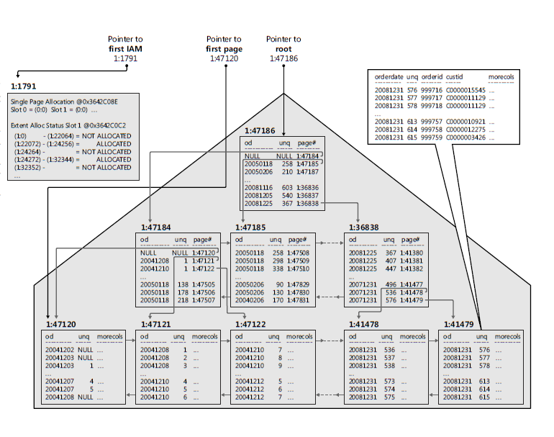
Index

Slide 15
Index
Well-designed indexes can reduce disk I/O operations and consume fewer system resources therefore improving query performance. Indexes can be helpful for a variety of queries that contain SELECT, UPDATE, DELETE, or MERGE statements.
When performing a table scan, the query optimizer reads all the rows in the table, and extracts the rows that meet the criteria of the query. A table scan generates many disk I/O operations and can be resource intensive. However, a table scan could be the most efficient method if, for example, the result set of the query is a high percentage of rows from the table.
When the query optimizer uses an index, it searches the index key columns, finds the storage location of the rows needed by the query and extracts the matching rows from that location.
Generally, searching the index is much faster than searching the table because unlike a table, an index frequently contains very few columns per row and the rows are in sorted order.
The query optimizer typically selects the most efficient method when executing queries. However, if no indexes are available, the query optimizer must use a table scan. Your task is to design and create indexes that are best suited to your environment so that the query optimizer has a selection of efficient indexes from which to select.

Slide 16
Clustered Index
Clustered indexes sort and store the data rows in the table or view based on their key values. These are the columns included in the index definition. There can be only one clustered index per table, because the data rows themselves can be sorted in only one order.
The only time the data rows in a table are stored in sorted order is when the table contains a clustered index. When a table has a clustered index, the table is called a clustered table. If a table has no clustered index, its data rows are stored in an unordered structure called a heap.

Slide 17
Non-Clustered Index
Nonclustered indexes have a structure separate from the data rows. A nonclustered index contains the nonclustered index key values and each key value entry has a pointer to the data row that contains the key value.
The pointer from an index row in a nonclustered index to a data row is called a row locator. The structure of the row locator depends on whether the data pages are stored in a heap or a clustered table. For a heap, a row locator is a pointer to the row. For a clustered table, the row locator is the clustered index key.
You can add nonkey columns to the leaf level of the nonclustered index to by-pass existing index key limits, 900 bytes and 16 key columns, and execute fully covered, indexed, queries.

Slide 18
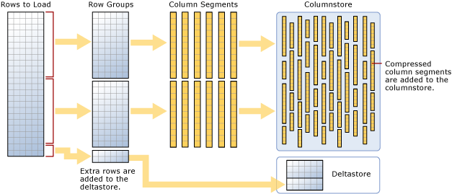
Columnstore Index
A columnstore index is a technology for storing, retrieving and managing data by using a columnar data format, called a columnstore. SQL Server supports both clustered and nonclustered columnstore indexes. Both use the same in-memory columnstore technology, but they do have differences in purpose and in features they support.
Benefits
Columnstore indexes work well for mostly read-only queries that perform analysis on large data sets. Often, these are queries for data warehousing workloads.
Columnstore indexes give high performance gains for queries that use full table scans, and are not well-suited for queries that seek into the data, searching for a particular value.

Slide 19
Using Search Arguments
Supporting Queries with Indexes
Search Arguments

Slide 20
SEARCH ARGUMENTS
Including the WHERE clause in a query, even if the predicate is very selective and supported by an index, does not guarantee that SQL Server is going to use an index. You need to write an appropriate predicate to allow the Query Optimizer to take advantage of the indexes. The Query Optimizer is not omnipotent. It can decide to use an index only when the arguments in the predicate are searchable. You have to learn how to write appropriate search arguments (SARGs).
To write an appropriate SARG, you must ensure that a column that has an index on it appears in the predicate alone, not as a function parameter.

Slide 21
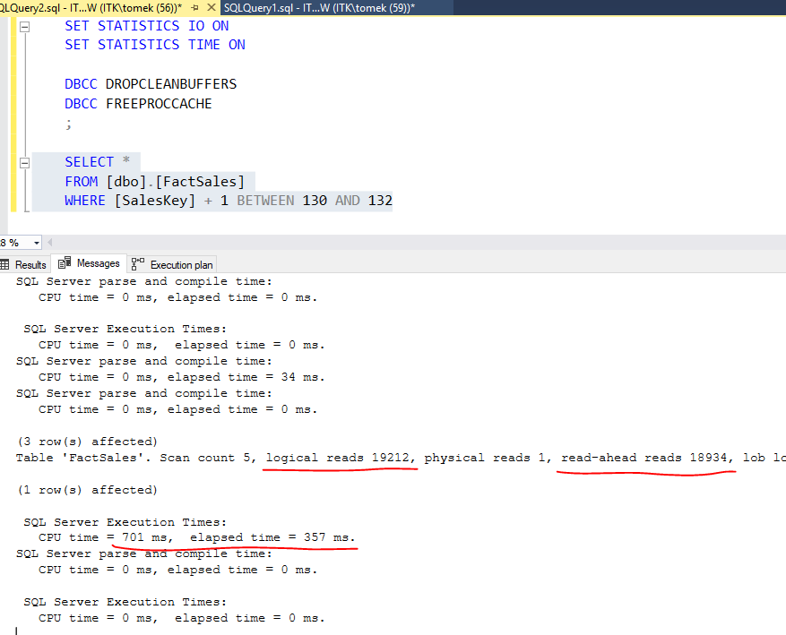
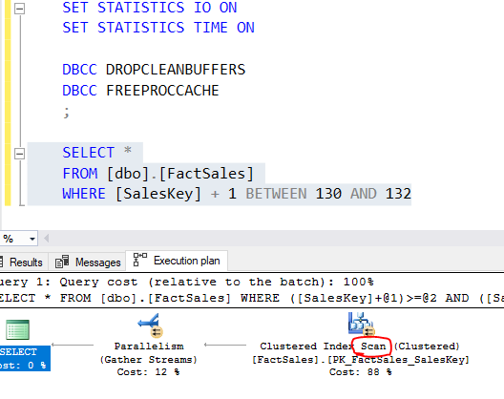
NON SARG

Slide 22
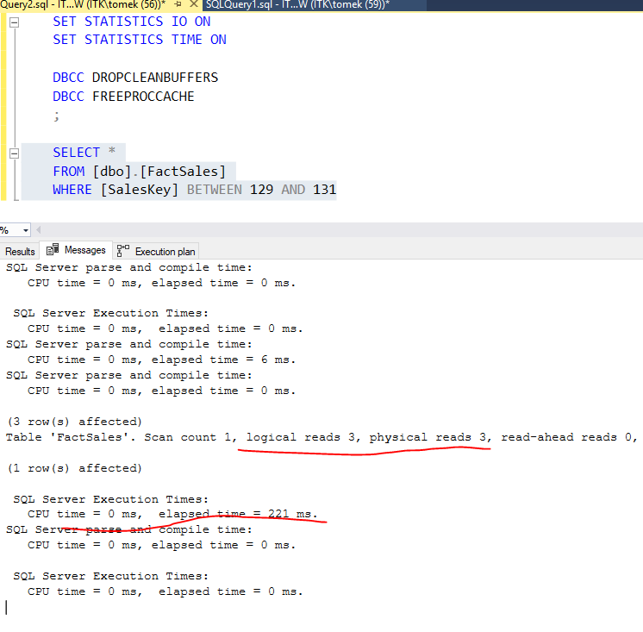
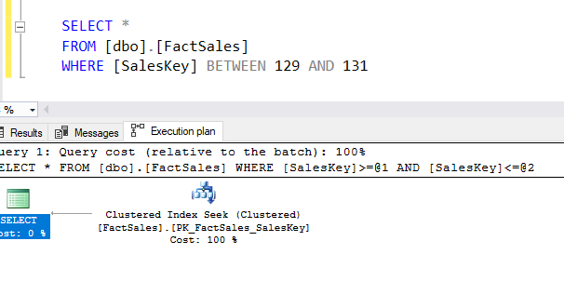
SARG

Slide 23
Understanding Statistics
Auto-Created Statistics
Manually Maintaining Statistics

Slide 24
Statistics
Statistics refers to the statistical information about the distribution of values in one or more columns of a table or an index. The SQL Server Query Optimizer uses this statistical information to estimate the cardinality, or number of rows, in the query result to be returned, which enables the SQL Server Query Optimizer to create a high-quality query execution plan. For example, based on these statistical information SQL Server Query Optimizer might decide whether to use the index seek operator or a more resource-intensive index scan operator in order to provide optimal query performance.
https://www.databasejournal.com/features/mssql/importance-of-statistics-and-how-it-works-in-sql-server-part-1.html

Slide 25
Auto-Created Statistics
By default, SQL Server creates statistics automatically. SQL Server creates statistics for each
index, and for single columns used as searchable arguments in queries. There are three database
options that influence the automatic creation of the statistics:
AUTO_CREATE_STATISTICS
When this option is set to on, SQL Server creates statistics automatically. This option is on by default, and you should leave this option on in the vast majority of cases.
AUTO_UPDATE_STATISTICS
This option, when turned on, enables SQL Server to automatically update statistics when there are enough changes in the underlying tables and indexes. With this option on, SQL Server also updates an out-of-date statistic during query optimization. SQL Server checks for outdated statistics before compiling a query and before executing a cached query. In general, you should leave this option turned on.
AUTO_UPDATE_STATISTICS _ASYNC
This option determines whether SQL Server uses synchronous or asynchronous statistics updates during query optimization. If the statistics are updated asynchronously, SQL Server cannot use them for the optimization of the query that triggered the update; however, SQL Server does not wait for the statistics update during the optimization phase. You should turn this option on only if your queries wait for synchronous updates of statistics too frequently and this causes performance problems.

Slide 26
Auto-Created Statistics
Each statistics object is stored in a statistics binary large object and is created on one or more columns. The statistics include a histogram with the distribution of values in the first column. Statistics objects on multiple columns store additional statistical information about the correlation of values among the columns. These correlation statistics are also called densities.
They are derived from the number of distinct rows of combinations of values of columns of a composite index.
There is a limit for the number of steps in histograms. A statistic can have maximally 200 steps. The statistics object also includes a header with metadata about the statistics, and a density vector to measure cross-column correlation. SQL Server computes an estimated number of rows that a query returns, or a cardinality estimate, with any of the data in the statistics object.

Slide 27
Manually Maintaining Statistics
There are only a few possible reasons to create statistics manually.
One example is when a query predicate contains multiple columns that have cross-column relationships; statistics on the multiple columns can help improve the query plan. Statistics on multiple columns contain cross-column densities that are not available in single-column statistics. However, if the columns are already in the same index, the multicolumn statistics object already exists, so you should not create an additional one manually.
Similarly to filtered indexes, you can also create filtered statistics.
Statistics created by SQL Server automatically are always created on all rows of a table. If queries frequently select from a subset of rows that has a unique data distribution, filtered statistics can improve query plans. Sometimes you can get a warning in the execution plan that a particular statistic is missing. You can create this statistic manually. However, before creating it manually, you should verify that AUTO_CREATE_STATISTICS and AUTO_UPDATE_STATISTICS database options are on and that the database is not read-only. If the database is read-only, the Query Optimizer cannot save statistics.

Slide 28
Manually Maintaining Statistics
Consider updating statistics manually in the following circumstances:
When query execution times are slow, and you know that the queries are written correctly and supported with appropriate indexes. Before you use query hints, update the statistics. SQL Server does not consider using the index with outdated statistics. Check also whether auto-updating statistics is turned off for the database.
When insert operations occur on ascending or descending key columns. Statistics are not updated for every single row; therefore, the number of rows inserted might be too small to trigger a statistics update. If queries select from the recently added rows, the current statistics might not have cardinality estimates for these new values. In addition, bulk inserting rows to a table or truncating a table can change the distribution of data a lot. Queries executed immediately after these operations might get a suboptimal execution plan because the statistics were not updated automatically yet.
After an upgrade from a previous version of SQL Server. Statistics information can change with a new version of SQL Server; to be on the safe side, you should update the statistics for the upgraded databases.

